Slide 1
Lecture 2:
Decision-making
Leadership Lab (organisational behaviour)
Jose Segovia-Martin

Slide 2
https://www.youtube.com/watch?v=OFPwDe22CoY

Slide 3
Take-home messages
Cultivate trust
Be inclusive

Slide 4
Previous lecture
Introduction to organaisational analysis.
Case study
Readings
How to Manage for Trust ( Paul J. Zak)
Recognize excellence.
Induce “challenge stress.” -> only if challenges are attainable.
Give people discretion in how they do their work.
Enable job crafting. -> allow people to choose which projects they will work.
Share information broadly.
Intentionally build relationships -> express interest for member’s personal wellbeing.
Show vulnerability.

Slide 5
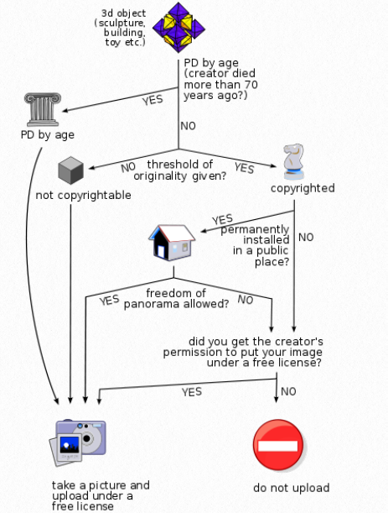
Decision-Making in Organizations

Slide 6
Two classes of organizational decision-making
James G. March
Logic of consequences (Rational choice theory) -> choices
Logic of appropriateness (Organisational process model) -> rule-following

Slide 7
Rational choice theory (logic of consequence)
Rational decisions entail four aspects:
Knowing your alternatives.
Knowing the consequences.
Knowing your preferences.
Building an algorithm. Two algorithms are generally discussed:
Rational person (“economic man”):
an agent that has clear preferences (is consistent),
models uncertainty via expected values,
always chooses to maximase its personal utility (optimise expected outcome for itself).
is generally assumed to have perfect knowledge of all previous events -> which is a feature of perfect competition in general equilibrium theory (it has been shown that under perfect competition the market can reach an equilibrium, called perfect market)
But perfect markets don’t exist and rationality is limited…
Boundedly rational person:
an agent that has inconsistency of preferences.
act as satisficer (doesn’t always optimise for itself, it seeks a satisfactory solution)

Slide 8
Rational choice theory (logic of consequence)
Humans do not undertake a full cost-benefit analysis to determine the optimal decision, but rather, choose an option that fulfils their adequacy criteria.
Campitelli, Guillermo; Gobet, Fernand (2010). "Herbert Simon's Decision-Making Approach: Investigation of Cognitive Processes in iExperts". Review of General Psychology.

Slide 9
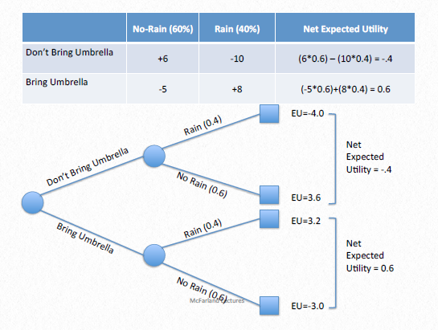
Rational choice theory (logic of consequence)
In winter, in Edinburgh, students will be faced with
the alternative of brining an umbrella or not.

Slide 10
Rational choice theory (logic of consequence)
There is a 40% chance of rain, so the consequence is
40% it may rain, and 60% it may not.

Slide 11
Rational choice theory (logic of consequence)
Now, imagine you prefer some alternatives over others. Let’s affix values from -10 to +10 in a matrix.

Slide 12
Rational choice theory (logic of consequence)
Now, imagine you prefer some alternatives over others. Let’s affix preference values from -10 to +10 in a matrix.

Slide 13
Rational choice theory (logic of consequence)
To calculate the EU of DBU we have to multiply the chance of rain 0.4 by preference value -10, plus the chance of no rain 0.6 by preference value 6.
Now, let’s calculate the expected utility for each scenario.

Slide 14
Rational choice theory (logic of consequence)
To calculate the EU of BU we have to multiply the chance of rain 0.4 by preference value 8, plus the chance of no rain 0.6 by preference value -5.
Now, let’s calculate the expected utility for each scenario.

Slide 15
Rational choice theory (logic of consequence)
To calculate the EU of BU we have to multiply the chance of rain 0.4 by preference value 8, plus the chance of no rain 0.6 by preference value -5.
Now, let’s calculate the expected utility for each scenario.

Slide 16
Rational choice theory (logic of consequence)
Result: bringing an umbrella is better than not bringing an umbrella.
Choice: brining umbrella

Slide 17
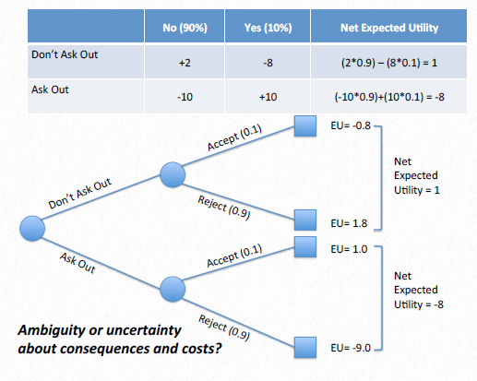
Rational choice theory (logic of consequence)
Exercise: Say you are wondering whether to ask someone out. Let’s consider that our chances of being accepted are 10% and our chances of being rejected are 90%. Assign values to your preferences in each scenario and calculate the expected net utility.

Slide 18
Rational choice theory (logic of consequence)
In all these cases there is clearly a ton of ambiguity. Weather reports are not that accurate, plus, we really have little evidence to go on in deciding if someone might be receptive to being asked out or not. Thus far, the rational actor model is an idealized model that assumes herculean abilities of decision makers. In reality, most of us are boundedly rational.
Humans do not undertake a full cost-benefit analysis to determine the optimal decision, but rather, choose an option that fulfils their adequacy criteria.
Campitelli, Guillermo; Gobet, Fernand (2010). "Herbert Simon's Decision-Making Approach: Investigation of Cognitive Processes in iExperts". Review of General Psychology.

Slide 19
Rational choice theory (logic of consequence)
So what would a bounded rationality model look like?
Herbert Simon (1947) related a theory of satisficing as a potential alternative.
Instead of calculating all the alternatives (humans don’t do that all the time) we start with one that is most near us - e.g., not bringing an umbrella or not asking someone out like we always do - and then we see if that option has a satisfactory consequence.

Slide 20
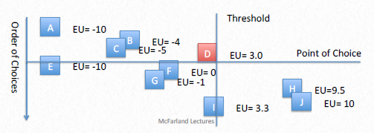
Rational choice theory (logic of consequence)
In most instances of satisficing behavior, we think about a choice threshold, and we stop somewhere along our sequential search of options when we find a choice that is “good enough”.

Slide 21
Rational choice theory (logic of consequence)
x
x
x
x
x
x
Rather than calculating all the cases, we begin with the nearest persons and move further afield (A to J), only deciding to ask them out as soon as we reach a person above our expected utility threshold of say, 3.

Slide 22
Rational choice theory (logic of consequence)
In this bounded rationality model, when we hit D, we find they are good enough, so we stop searching.

Slide 23
Organisational process model (logic of appropriateness)
Most of the time in organizations, people follow rules even if it is not obviously in their self-interest to do so.
When a problem or issue confronts an organization, it often becomes a question of finding the appropriate rules to follow. Instead of valuing alternatives in terms of their consequences, rule following matches situations and identities.

Slide 24
Organisational process model (logic of appropriateness)
This model is used whenever people follow rules, traditions (path dependence), cultural norms, pre-existent rules or and heuristics (like rules of thumb).
This model is less about finding a desired outcome than making sense of situations and discerning what rules apply and why.
The primary product of this decision-making model may be less the decision outcome, than the decision process.
In summary: the process, the how (e.g. citizen engagement, gender and ethnic inclusion, consensus building) matters more than the temporal optimisation of consequences.

Slide 25
Activities
Reading: Case study: Cuban missile crisis (Textbook p.22-28)
Prisoner's dilemma:
Video
Lessons from the Prisoner's Dilemma:
https://www.economicsnetwork.ac.uk/archive/poulter/pd.htm
Play the game against a variety of bots and then discuss with your classmates the Questions in section 7. Submit your answers to github classroom using a txt file.

